Slide 1
14”
2.5”
8.5”
Bottom base board

Slide 2
14”
2.5”
Side wall L
3.5”
8.5”
5”
0.75”
Side wall R
2.5”
Side walls

Slide 3



14”
5”
Keypad panel
2.5”
$$φ\frac{3}{8}"$$
Joystick
$$φ1"$$
6”
5”
Key A
3.5”
$$φ1"$$
6”
Key B
3”
2”

Slide 5
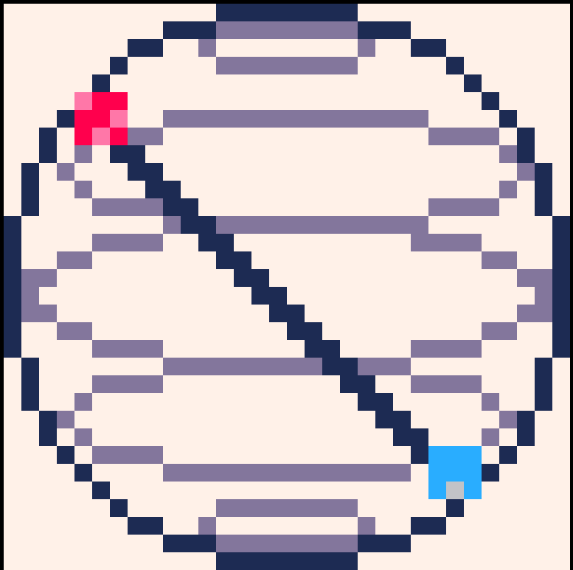







Q A R C A D E
Decors

